Slide 1

1st Meeting for Project development and Implementation
Agenda:
Review of the study’s paper progress
Review of Purchased Materials
Android App Alpha stage testing and focus group feedback
Introduction to ASANA project management tool
Introduction to ATOM and GITHUB

Slide 2
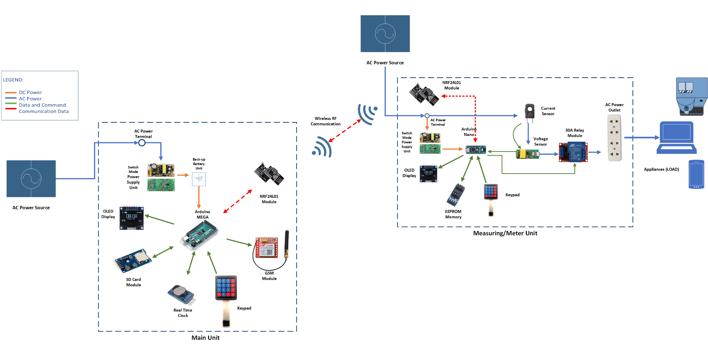
Review of the study’s paper progress
Notes:
Current primary objective:
Work on the development of the meter unit:

Slide 3

Android App Alpha stage testing and focus group feedback

Slide 4

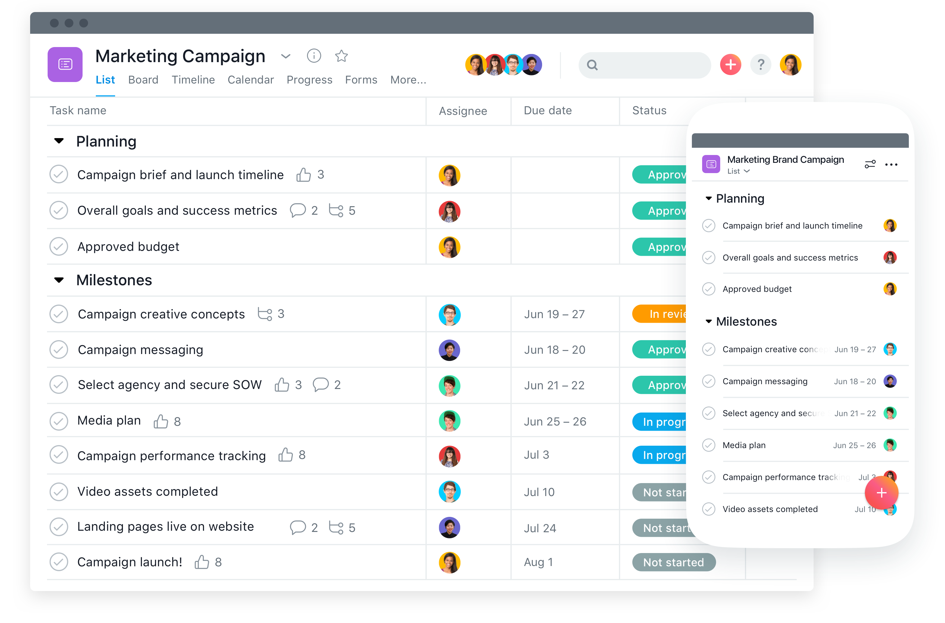
Introduction to ASANA project management tool

Slide 5
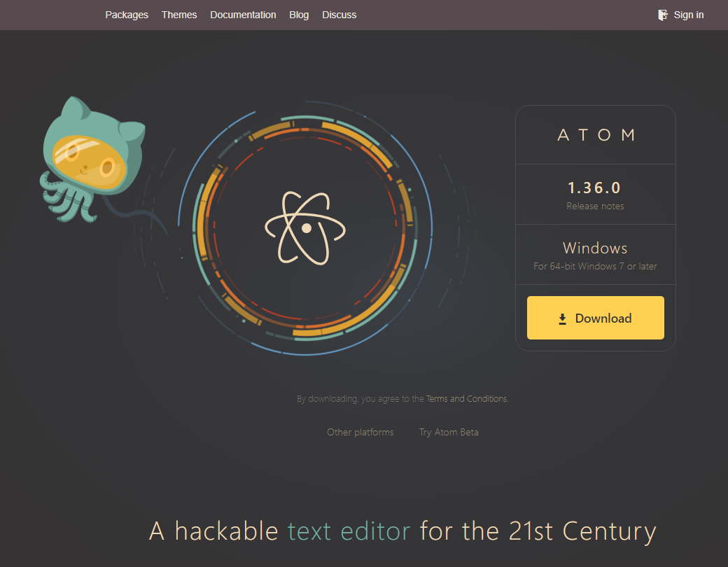

Introduction to ATOM text editor and GITHUB

